Slide 1
Life Expectancy
Analytics
Group 525
A20437298 Boyun Jang
A20437179 Minguk Kim

Slide 2
CONTENTS
Introduction
Data
Problems to be Solved
Solutions
Experiments and Results
Methods and Process
Evaluations and results
Conclusions and Future Work
Conclusions
Limitations
Potential Improvements or Future Work

Slide 3
Ⅰ. Introduction
Introduce the background and motivations
Notes:
기대수명은 인간의 교육 수준과 생활 수준 외에 각국의 인간개발지수(HDI)를 측정하는 요인 중 하나이다. 그것은 특정 영역의 삶의 질을 묘사하는 데 사용된다. 기대수명의 차이는 의료의 필요성과 사회적 지원의 개선을 증명하기 위해 인용되기도 한다. 각국의 의료·사회적 지원의 필요성을 증명하기 위해 국가 사망률, 경제적 요인, 사회적 요인, 기타 건강 관련 요인 등 기대 수명 요인을 분석한다. 사망률을 높이기 위해 특정 지역의 사망률에 영향을 미치는 취약한 질병과 환경을 예측해 인구수명을 개선하기 위해 어떤 개선이 필요한지 제시하겠다.
Life expectancy is one of the factors that measure human development index (HDI) in each country besides human education level and living standard. It is used to describe the quality of life in a particular area. The difference in life expectancy is also cited to demonstrate the need for medical care and the improvement of social support.
In order to prove the necessity of medical and social support for each country, we are going to analyze the factors of life expectancy such as the national mortality rate, economic factors, social factors and other health-related factors.
We will present what kind of improvements are needed to improve the life expectancy of the population by predicting the vulnerable diseases and environments that affect the mortality rate in a specific area in order to improve the mortality rate.

Slide 4
Ⅰ. Introduction Introduce the background and motivations
National
Mortality
Economic
Life Expectancy
Social
Health
Related
Which factors are needed to improve the life expectancy?
Notes:
기대수명은 인간의 교육 수준과 생활 수준 외에 각국의 인간개발지수(HDI)를 측정하는 요인 중 하나이다. 그것은 특정 영역의 삶의 질을 묘사하는 데 사용된다. 기대수명의 차이는 의료의 필요성과 사회적 지원의 개선을 증명하기 위해 인용되기도 한다. 각국의 의료·사회적 지원의 필요성을 증명하기 위해 국가 사망률, 경제적 요인, 사회적 요인, 기타 건강 관련 요인 등 기대 수명 요인을 분석한다. 사망률을 높이기 위해 특정 지역의 사망률에 영향을 미치는 취약한 질병과 환경을 예측해 인구수명을 개선하기 위해 어떤 개선이 필요한지 제시하겠다.
Life expectancy is one of the factors that measure human development index (HDI) in each country besides human education level and living standard. It is used to describe the quality of life in a particular area. The difference in life expectancy is also cited to demonstrate the need for medical care and the improvement of social support.
In order to prove the necessity of medical and social support for each country, we are going to analyze the factors of life expectancy such as the national mortality rate, economic factors, social factors and other health-related factors.
We will present what kind of improvements are needed to improve the life expectancy of the population by predicting the vulnerable diseases and environments that affect the mortality rate in a specific area in order to improve the mortality rate.

Slide 5
Ⅱ. Data
Introduce information about data

Slide 6
Ⅱ. Data Introduce data
Life Expectancy Data
Source: Kaggle
Data set Information: life expectancy and health factors in 193 countries
(WHO data store website)
Economic data(UN website)
22columns 2938 rows
Type: csv file
Notes:
Data sets related to life expectancy and health factors in 193 countries were collected from the same WHO data store website. Economic data was collected on the UN website. Only representative elements were selected from all categories of health-related factors. The data set consists of 22 columns and 2938 rows, which means 20 prediction variables.

Slide 7
Ⅱ. Data Variables
X variables
Life Expectancy
Meaningful
Variables
Variables
Country
Year
Developing Status
Adult Mortality
Infant deaths
Alcohol consumption
Hepatitis B immunization
Measles
BMI
Under five death
Polio
Total expenditure
Diphtheria
HIV/AIDS
GDP
Population
Thinness 1-19 years
Thinness 5-9 years
Income composition of resources
Schooling
Notes:
Data set에 있는 x variables에서 meaningful variables 해서 life expectancy 구하는 것 이 목표.
Variables 는 ~~이런 게 있다.

Slide 8
Ⅱ. Data Variables
Variable | Description
Country | Country
Year | Year
Status | Developed or Developing status
Life expectancy | Life Expectancy in age
Adult Mortality | Adult Mortality Rates of both sexes (probability of dying between 15 and 60 years per 1000 population)
Infant deaths | Number of Infant Deaths per 1000 population
Alcohol | Alcohol, recorded per capita (15+) consumption (in litres of pure alcohol)
percentage expenditure | Expenditure on health as a percentage of Gross Domestic Product per capita(%)
Hepatitis B | Hepatitis B (HepB) immunization coverage among 1-year-olds (%)
Measles | Measles - number of reported cases per 1000 population
BMI | Average Body Mass Index of entire population
under-five deaths | Number of under-five deaths per 1000 population
Polio | Polio (Pol3) immunization coverage among 1-year-olds (%)
Total expenditure | General government expenditure on health as a percentage of total government expenditure (%)
Diphtheria | Diphtheria tetanus toxoid and pertussis (DTP3) immunization coverage among 1-year-olds (%)
HIV/AIDS | Deaths per 1 000 live births HIV/AIDS (0-4 years)
GDP | Gross Domestic Product per capita (in USD)
Population | Population of the country
thinness 1-19 years | Prevalence of thinness among children and adolescents for Age 10 to 19 (% )
thinness 5-9 years | Prevalence of thinness among children for Age 5 to 9(%)
Income composition of resources | Human Development Index in terms of income composition of resources (index ran-ging from 0 to 1)
Schooling | Number of years of Schooling(years)
Notes:
대충 이러이러한 variables 있는데, 여기서 life expectancy 어디에 있고, x 통해 y 설명

Slide 9
Ⅲ. Problems to be Solved
List the problems I want to solve

Slide 10
Ⅲ. Problems to be Solved Main goal
Various
Elements
Life Expectancy
Predict what elements will affect to improve anticipated life expectancy
Discover patterns that can increase the life expectancy
Notes:
The main goal of this project is to predict if the various data elements we collect will affect the average life expectancy.
The following objectives are based on these key objectives.
The first goal is to predict what vulnerable diseases and environments will affect the mortality rate in a given area in order to improve anticipated life expectancy.
The second goal is to analyze the data and discover patterns that can increase the life expectancy. For example, we can analyze if increasing medical expenditure or increasing the compulsory schooling period can effect positively the average life expectancy.

Slide 11
Ⅳ. Solutions
List the solutions for the problems

Slide 12
Ⅳ. Solutions Process
Life Expectancy Analytics
Predictive model : Linear regression
Pure variables
Polynominal
Polynominal + interaction term
Independent and Dependent variables
Notes:
Potential Solutions Process 나열
Make sure your solutions can solve the problems in part 3 one by one
If you are going to build predictive models, clearly indicate the dependent and independent variables

Slide 13
Ⅳ. Solutions Process
Dependent variable:
Life Expectancy – Life Expectancy in age
Independent variable:
Country - Country
Year - Year
Status – Developing or Developing status
Adult Mortality - Adult Mortality Rates of both sexes (probability of dying between 15 and 60 years per 1000 population)
Infant deaths - Number of Infant Deaths per 1000 population
Alcohol - Alcohol, recorded per capita (15+) consumption (in liters of pure alcohol)
Percentage of expenditure - Expenditure on health as a percentage of Gross Domestic Product per capita(%)
Hepatitis B - Hepatitis B (HepB) immunization coverage among 1-year-olds (%)
Measles - Measles - number of reported cases per 1000 population
BMI - Average Body Mass Index of entire population
Under-five deaths - Number of under-five deaths per 1000 population
Polio - Polio (Pol3) immunization coverage among 1-year-olds (%)
Total expenditure - General government expenditure on health as a percentage of total government expenditure (%)
Diphtheria - Diphtheria tetanus toxoid and pertussis (DTP3) immunization coverage among 1-year-olds (%)
HIV/AIDS - Deaths per 1 000 live births HIV/AIDS (0-4 years)
GDP - Gross Domestic Product per capita (in USD)
Population - Population of the country
Thinness 1-19 years - Prevalence of thinness among children and adolescents for Age 10 to 19 (% )
Thinness 5-9 years - Prevalence of thinness among children for Age 5 to 9(%)
Income composition of resources - Human Development Index in terms of income composition of resources (index ranging from 0 to 1)
Schooling - Number of years of Schooling(years)
Notes:
Potential Solutions Process 나열
X,Y 설정
Make sure your solutions can solve the problems in part 3 one by one
If you are going to build predictive models, clearly indicate the dependent and independent variables

Slide 14
Ⅴ. Experiments and Results
1). Methods and Process
2). Evaluations and Results
Notes:
Model build process
Explain Code

Slide 15
Ⅴ. Experiments and Results
5.1. Methods and Process
Determine
Y and X
Build Model
Feature Selection
Preprocessing
Size of data
Model
Evaluation
Model
Qualification
Check Multi
-linearity
Notes:
Solve the problems your proposed one by one
Give the necessary codes, snapshots and explanations

Slide 16
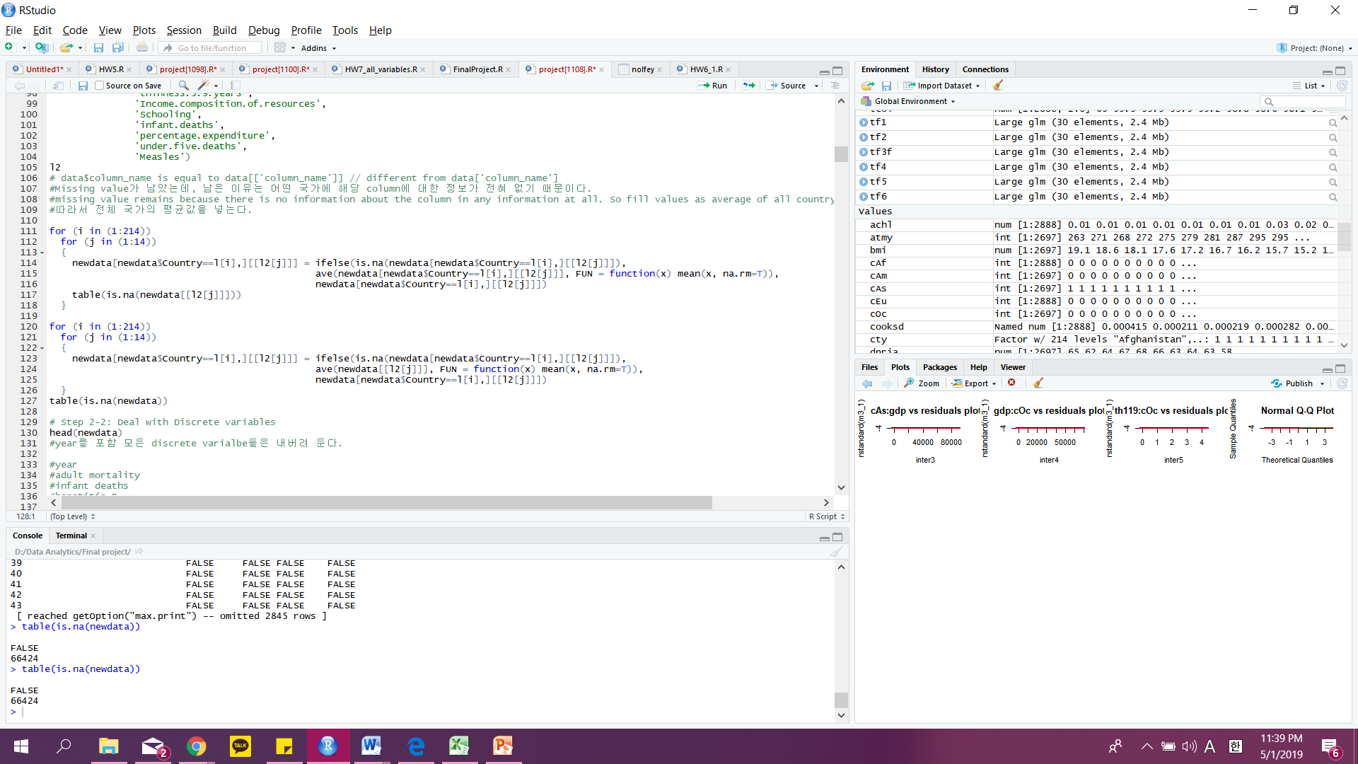
Ⅴ. Experiments and Results
5.1. Methods and Process
Data preprocessing
Missing value
Notes:
codes
Solve the problems your proposed one by one
Give the necessary codes, snapshots and explanations

Slide 17
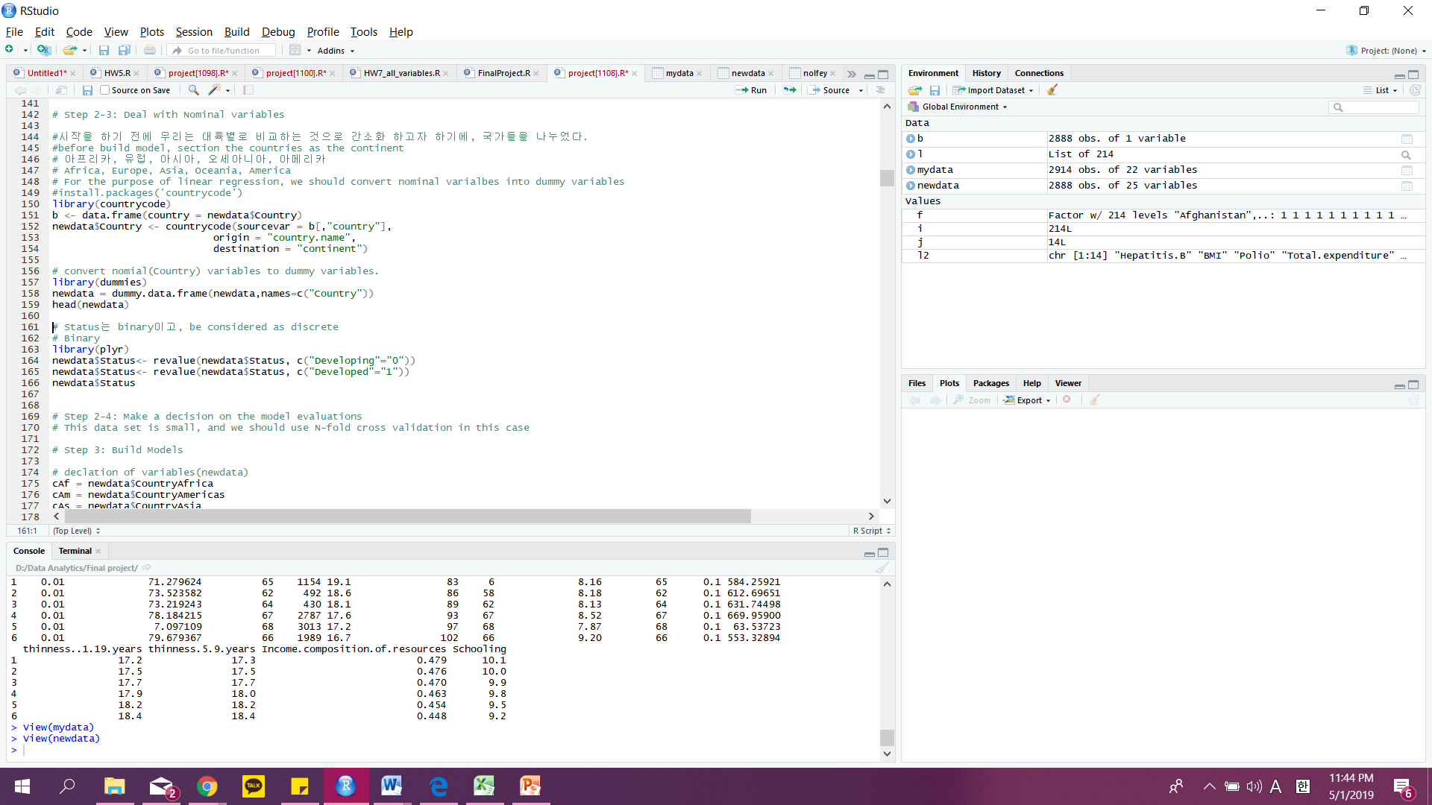
Ⅴ. Experiments and Results
5.1. Methods and Process
Data preprocessing
Missing value
Discrete variables
Nominal variables
Countries -> Continent
Dummy variables (Continent, Status)
Notes:
codes
Solve the problems your proposed one by one
Give the necessary codes, snapshots and explanations
All variables are discrete
Convert data to dummy variables

Slide 18
Ⅴ. Experiments and Results
5.1. Methods and Process
Data preprocessing
Missing value
Discrete variables
Nominal variables
Countries -> Continent
Dummy variables (Continent, Status)
Make a decision on the model evaluations
- Data is small(2938 rows), use N-fold cross validataion
Notes:
codes
Solve the problems your proposed one by one
Give the necessary codes, snapshots and explanations

Slide 19
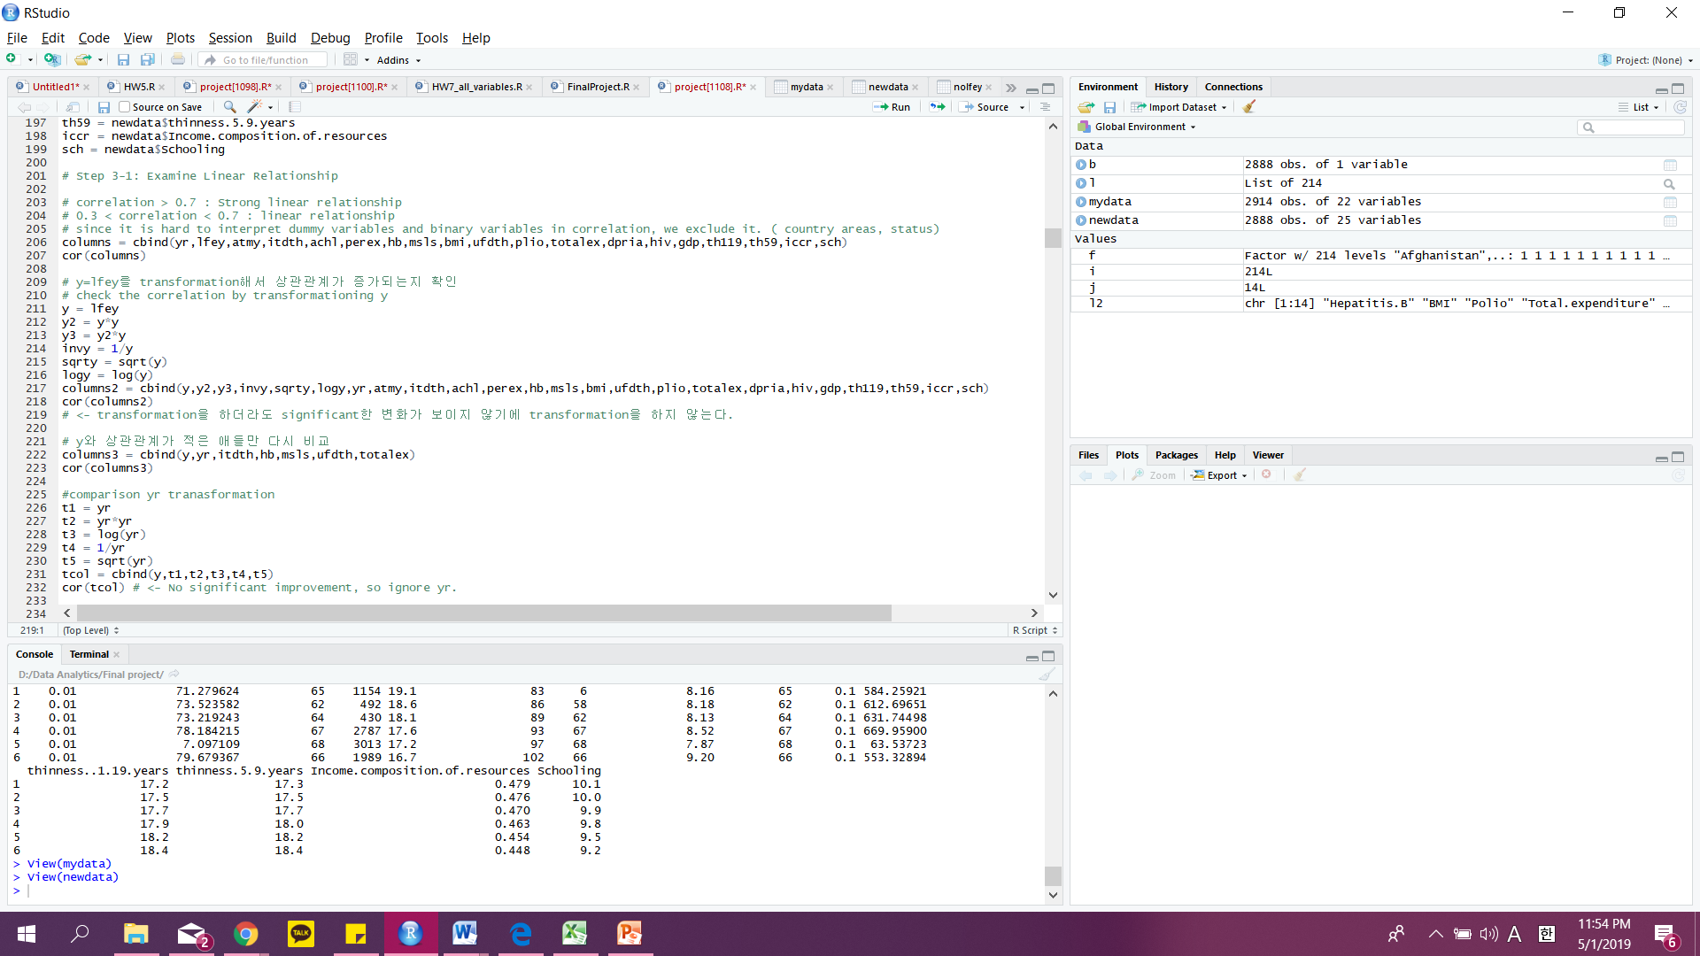
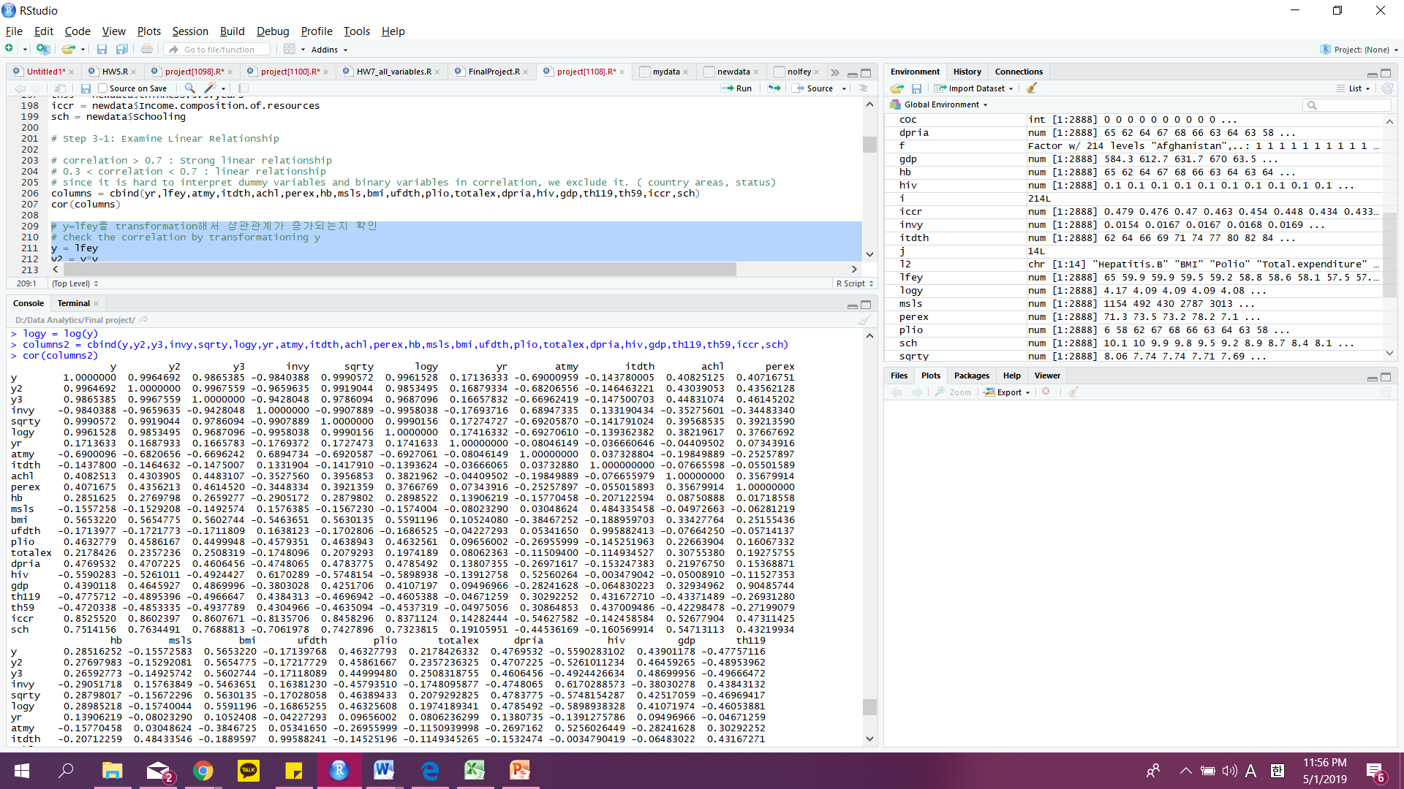
Ⅴ. Experiments and Results
5.2. Evaluations and Results
Build Models
Examine Linear Relationship
check the correlation by transforming Y
Notes:
Feature selection
Given a same problem, you may have several solutions or build several models
Evaluate your solutions based on selected metrics and compare them
No significant change in the correlation. -> just use Y,

Slide 20
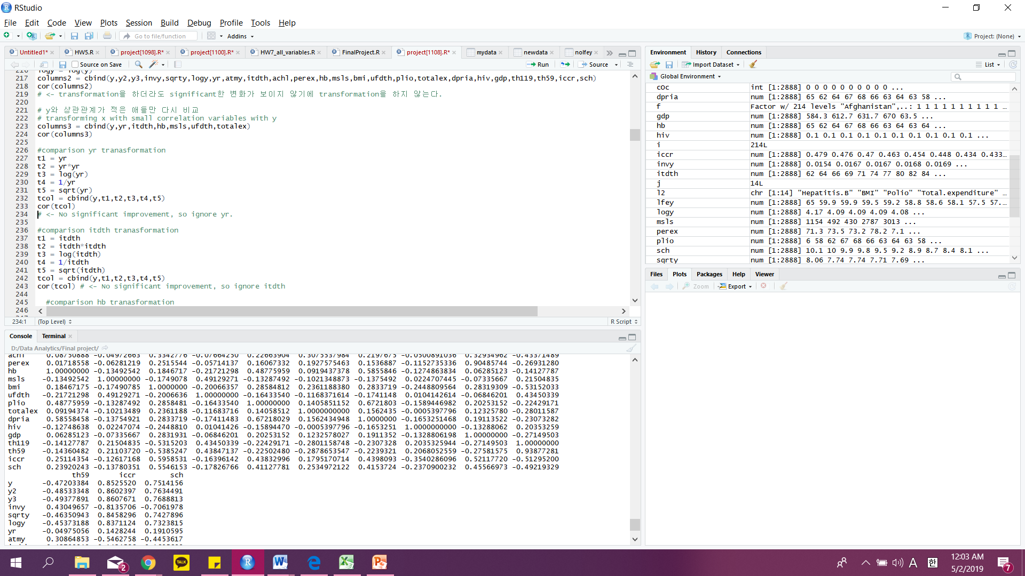
Ⅴ. Experiments and Results
5.2. Evaluations and Results
Build Models
Examine Linear Relationship
check the correlation by transforming Y
Transforming X with a small correlation with Y
Transformed ‘Hepatitis B’, ‘under-five deaths’ >0.3
So, doing transformation for these variables.
hb-> hb^2
ufdth -> log(ufdth)
ignore yr, msls, totalex, itdth
Notes:
Feature selection
Given a same problem, you may have several solutions or build several models
Evaluate your solutions based on selected metrics and compare them
No significant change in the correlation. -> just use Y,

Slide 21
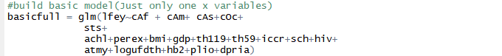
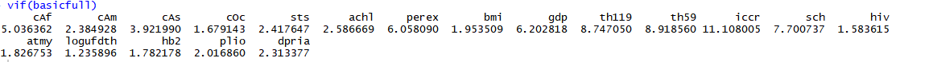
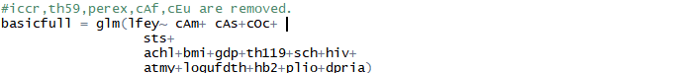
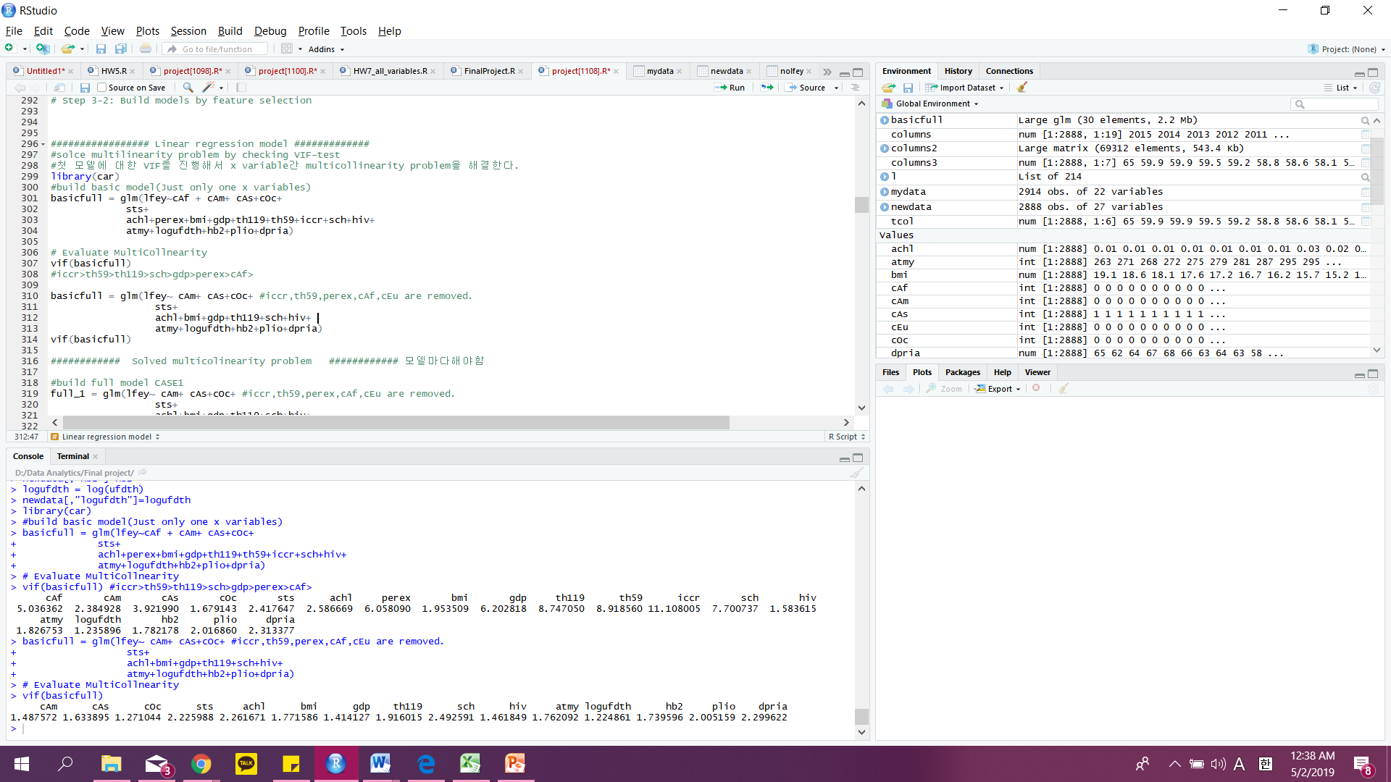
Ⅴ. Experiments and Results
5.2. Evaluations and Results
Build Models
Examine Linear Relationship
Build models by feature selection
VIF-test to model
Notes:
Feature selection
Given a same problem, you may have several solutions or build several models
Evaluate your solutions based on selected metrics and compare them
VIF-test
#iccr>th59>th119>sch>gdp>perex>cAf>
#iccr,th59,perex,cAf,cEu are removed.

Slide 22
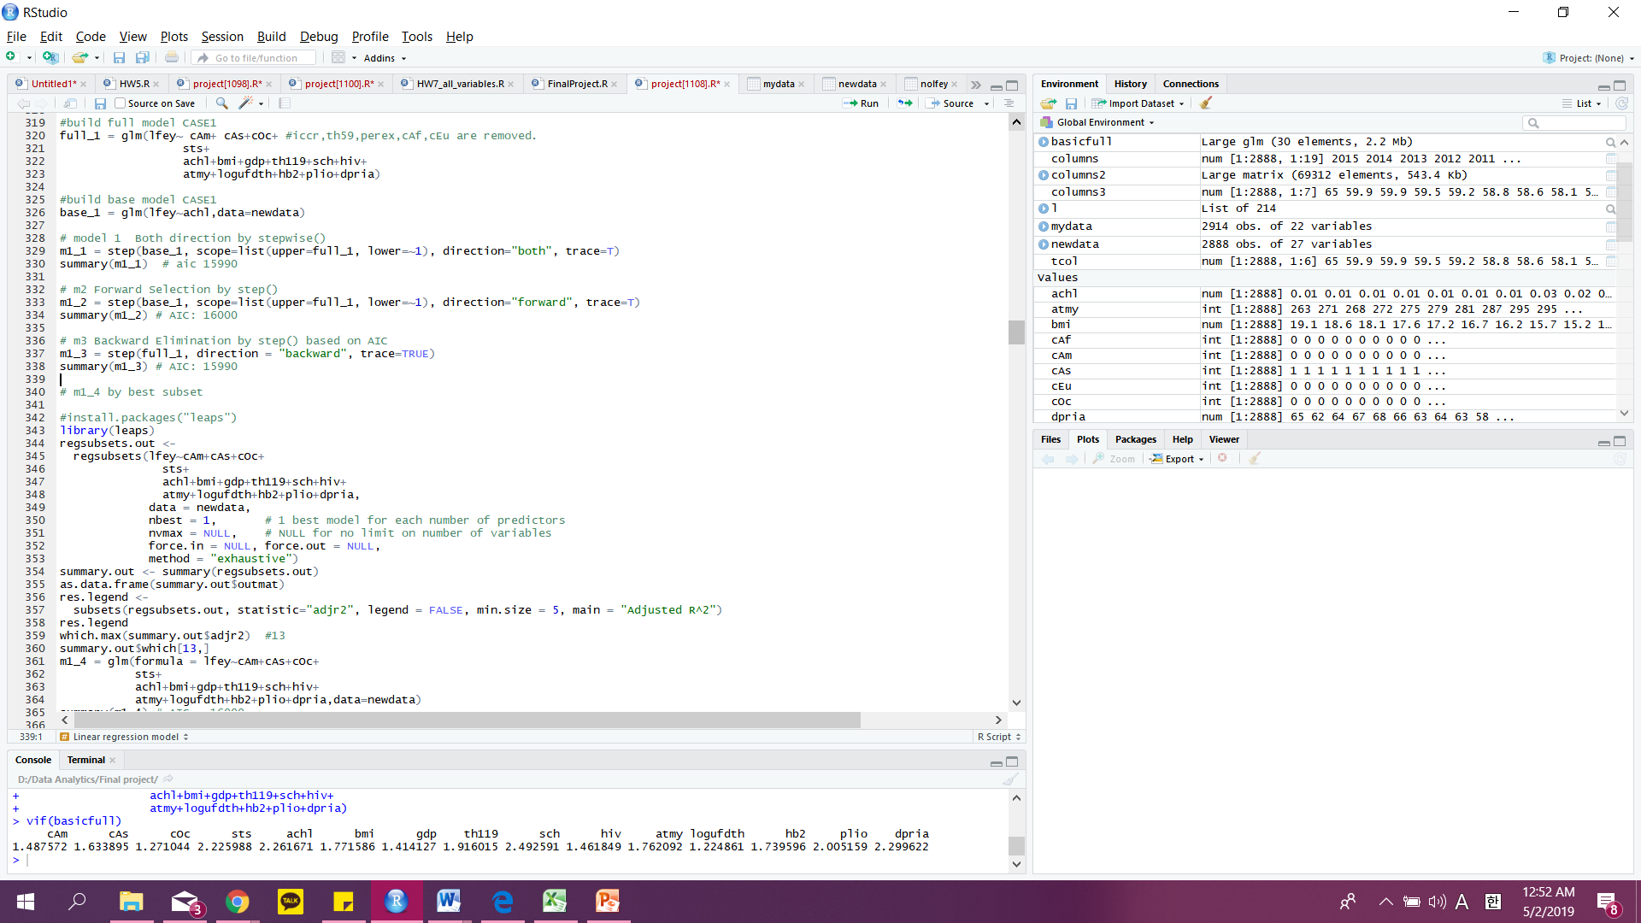
Ⅴ. Experiments and Results
5.2. Evaluations and Results
Build Models
Examine Linear Relationship
Build models by feature selection
VIF-test to model
Feature selection (both, backward, forward, best subset)
Notes:
Feature selection
Given a same problem, you may have several solutions or build several models
Evaluate your solutions based on selected metrics and compare them
VIF-test
#iccr>th59>th119>sch>gdp>perex>cAf>
#iccr,th59,perex,cAf,cEu are removed.

Slide 23
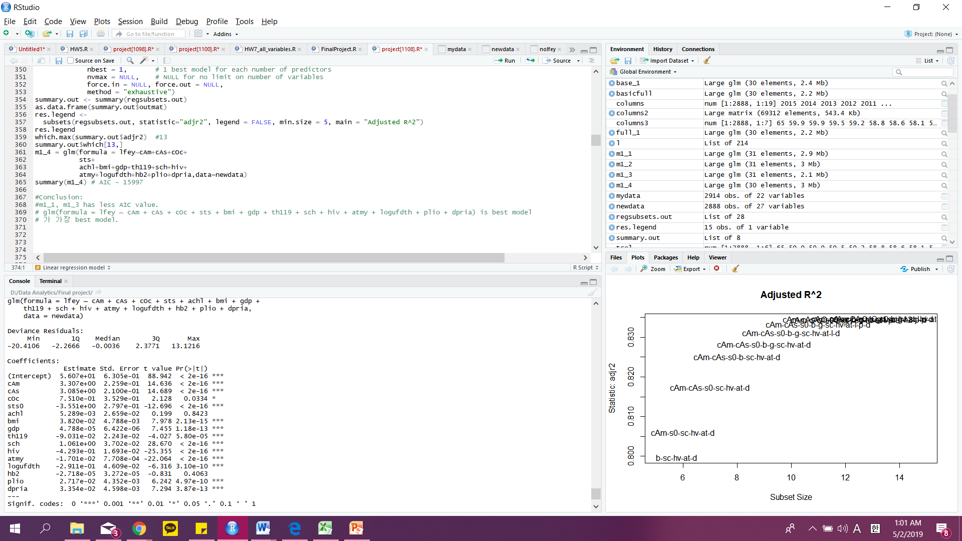
Ⅴ. Experiments and Results
5.2. Evaluations and Results
Build Models
Examine Linear Relationship
Build models by feature selection
VIF-test to model
Feature selection (both, backward, forward, best subset)
Notes:
Feature selection
Given a same problem, you may have several solutions or build several models
Evaluate your solutions based on selected metrics and compare them
VIF-test
#iccr>th59>th119>sch>gdp>perex>cAf>
#iccr,th59,perex,cAf,cEu are removed.

Slide 24
Ⅴ. Experiments and Results
5.2. Evaluations and Results
Build Models
Examine Linear Relationship
Build models by feature selection
VIF-test to model
Feature selection (both, backward, forward, best subset)
Notes:
Feature selection
Given a same problem, you may have several solutions or build several models
Evaluate your solutions based on selected metrics and compare them
VIF-test
#iccr>th59>th119>sch>gdp>perex>cAf>
#iccr,th59,perex,cAf,cEu are removed.

Slide 25
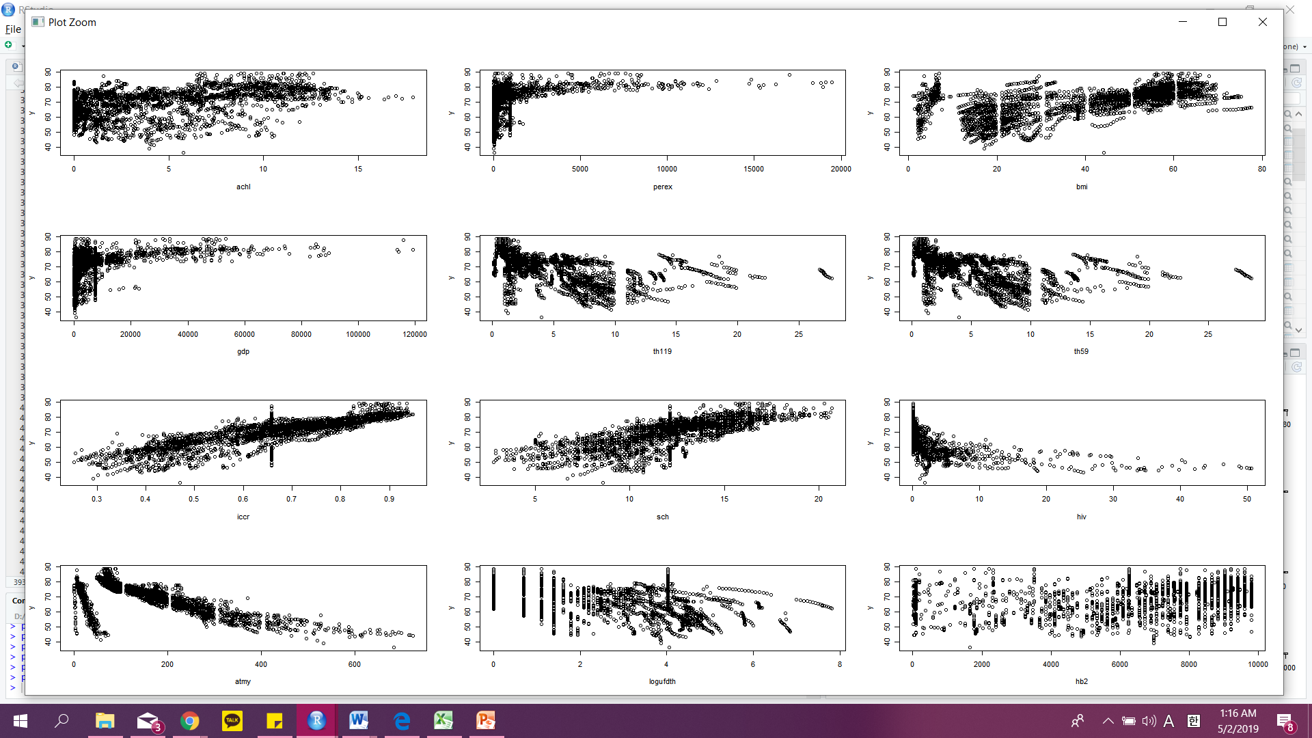
Ⅴ. Experiments and Results
5.2. Evaluations and Results
Build Models
Examine Linear Relationship
Build models by feature selection
VIF-test to model
Feature selection (both, backward, forward, best subset)
Polynominal check
Notes:
Feature selection
Given a same problem, you may have several solutions or build several models
Evaluate your solutions based on selected metrics and compare them
Polynominal 의심#Conclusion: th119,th59, logufdth가 polynomial로 의심된다 th59는 multicollinearity problem에서 삭제됨.

Slide 26
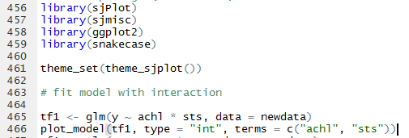
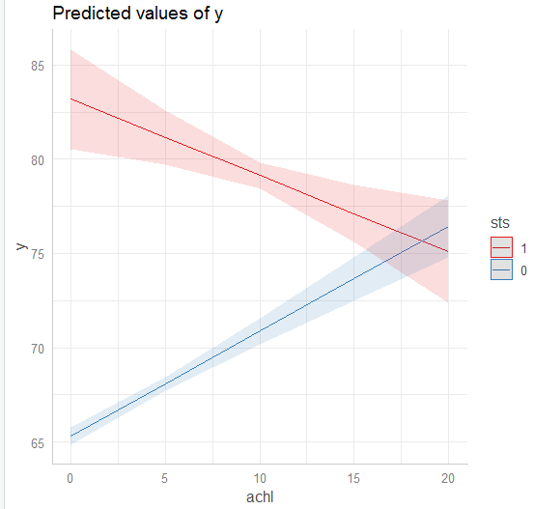
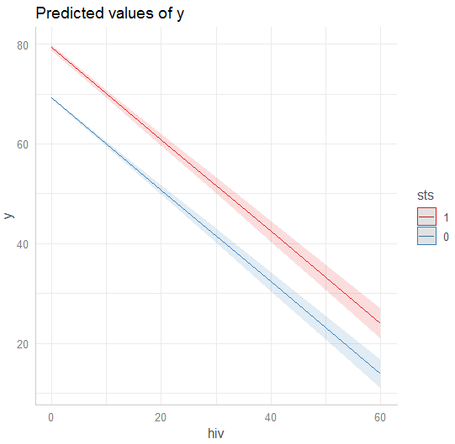
Ⅴ. Experiments and Results
5.2. Evaluations and Results
Build Models
Examine Linear Relationship
Build models by feature selection
VIF-test to model
Feature selection (both, backward, forward, best subset)
Polynominal check –build new model
Interaction term check – build new model
Notes:
Feature selection
Given a same problem, you may have several solutions or build several models
Evaluate your solutions based on selected metrics and compare them
Polynominal 의심#Conclusion: th119,th59, logufdth가 polynomial로 의심된다 th59는 multicollinearity problem에서 삭제됨.

Slide 27
Ⅴ. Experiments and Results
5.2. Evaluations and Results
Build Models
Examine Linear Relationship
Build models by feature selection
F-test: n-fold, no f-test
Notes:
Feature selection
Given a same problem, you may have several solutions or build several models
Evaluate your solutions based on selected metrics and compare them
Polynominal 의심#Conclusion: th119,th59, logufdth가 polynomial로 의심된다 th59는 multicollinearity problem에서 삭제됨.

Slide 28
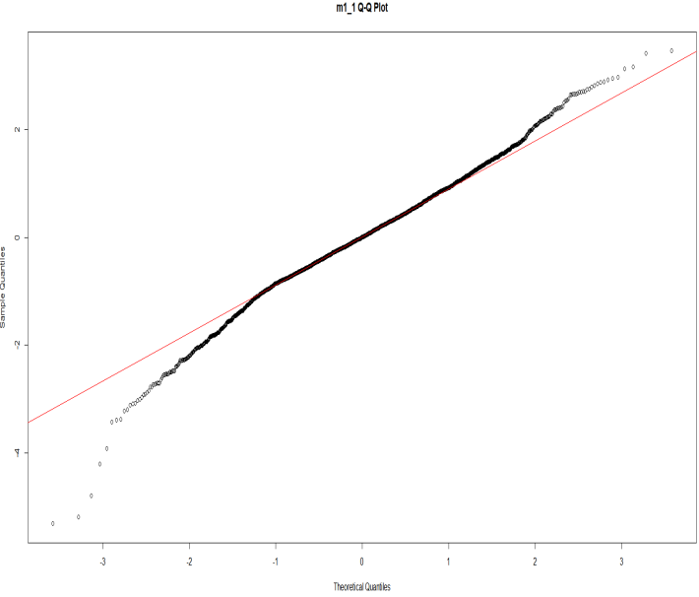


Ⅴ. Experiments and Results
5.2. Evaluations and Results
Build Models
Examine Linear Relationship
Build models by feature selection
F-test: n-fold, no f-test
Residual analysis
Notes:
Feature selection
Given a same problem, you may have several solutions or build several models
Evaluate your solutions based on selected metrics and compare them
Polynominal 의심#Conclusion: th119,th59, logufdth가 polynomial로 의심된다 th59는 multicollinearity problem에서 삭제됨.

Slide 29
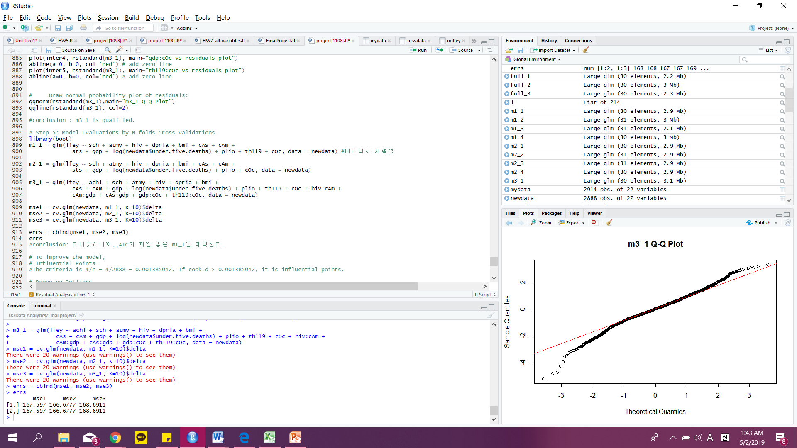
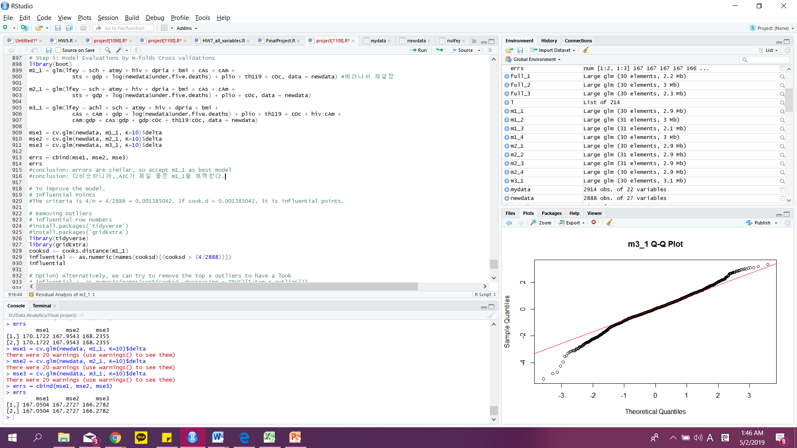
Ⅴ. Experiments and Results
5.2. Evaluations and Results
Build Models
Examine Linear Relationship
Build models by feature selection
F-test: n-fold, no f-test
Residual analysis
Model Evaluations by N-folds Cross validations
Notes:
Feature selection
Given a same problem, you may have several solutions or build several models
Evaluate your solutions based on selected metrics and compare them
Polynominal 의심#Conclusion: th119,th59, logufdth가 polynomial로 의심된다 th59는 multicollinearity problem에서 삭제됨.

Slide 30
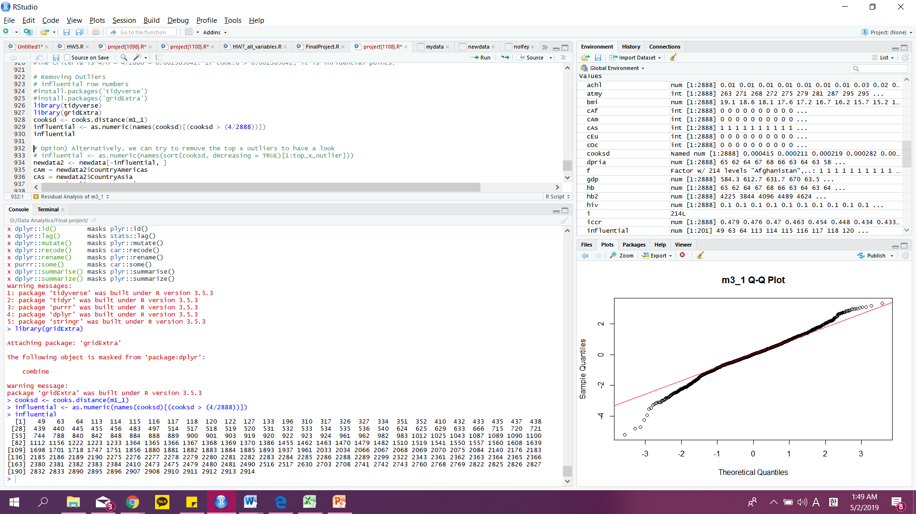
Ⅴ. Experiments and Results
5.2. Evaluations and Results
Build Models
Examine Linear Relationship
Build models by feature selection
F-test: n-fold, no f-test
Residual analysis
Model Evaluations by N-folds Cross validations
Influential Points
Notes:
Feature selection
Given a same problem, you may have several solutions or build several models
Evaluate your solutions based on selected metrics and compare them
Polynominal 의심#Conclusion: th119,th59, logufdth가 polynomial로 의심된다 th59는 multicollinearity problem에서 삭제됨.

Slide 31
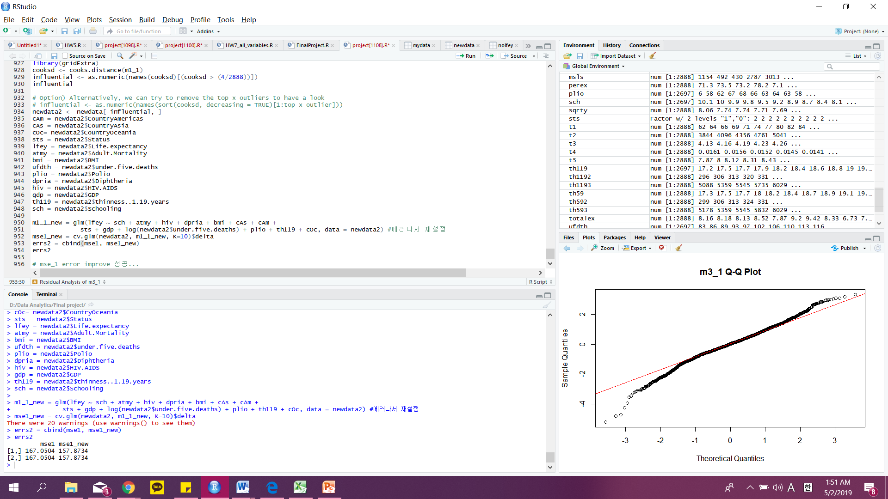
Ⅴ. Experiments and Results
5.2. Evaluations and Results
Build Models
Examine Linear Relationship
Build models by feature selection
F-test: n-fold, no f-test
Residual analysis
Model Evaluations by N-folds Cross validations
Influential Points
Final model
Error decreased!
Notes:
Feature selection
Given a same problem, you may have several solutions or build several models
Evaluate your solutions based on selected metrics and compare them
Polynominal 의심#Conclusion: th119,th59, logufdth가 polynomial로 의심된다 th59는 multicollinearity problem에서 삭제됨.

Slide 32
Ⅵ. Conclusions and Future Work
1). Conclusions
2). Limitations
3). Potential Improvements or Future Work

Slide 33
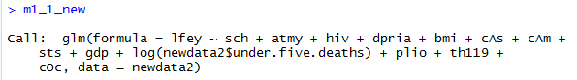
Ⅵ. Conclusions and Future Work s
6.1. Conclusions
Final Model
Life Expectancy =
(1.003e+00*Schooling)+(-1.844e-02*Adult.Mortality) + (-4.094e-01*HIV.AIDS) +
(3.460e-02*Diphtheria) + (3.565e-02*BMI)+ (-3.633e+00*(Status=0)) + (5.132e-05*GDP) +
(-2.801e-01*log(Under.Five.Deaths)) + (2.157e-02*Polio) + (-9.838e-02*thinness..1.19.years)
Notes:
A short summary of your whole project and conclusions, such as what you want to, why you want to do so, which solutions you use, and which findings or final results you get finally.
Linear Regression analysis : 우리는 다음과 같은 식을 얻었습니다. 선형회귀식을 분석함에 있어서 Country variables은 의미가 없는 것 같아서 삭제하고 다시 정리 하였습니다.

Slide 34
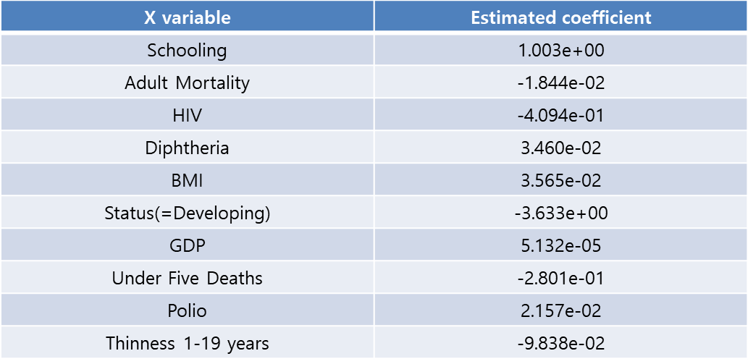
Ⅵ. Conclusions and Future Work s
6.1. Conclusions
Notes:
정리하자면, 전세계에 대한 기대수명에 영향을 미치는 요소들은 다음과 같습니다.
첫 번째로 후진국의 경우에는 선진국보다 기대수명이 -3.6정도 낮았고,
두 번째로 많은 요소들이 있겠지만, 걔중에 가장 눈에 띄는 것은 Schooling과 GDP가 있는데,
학교 교육을 많이 받을수록 significant 하게 기대 수명이 올라간다는 점과, GDP가 증가한다고 해서 수명이 significant하게 증가한다는 것이 아니라는 점을 발견하였습니다.

Slide 35
Ⅵ. Conclusions and Future Work s
6.2. Limitations
Life Expectancy Data
Source: Kaggle
Data set: 22columns 2938 rows
Type: csv file
Notes:
Introduce the limitations of your work
이번 데이터 조사의 한계는 선형식을 구해서 그 coefficient를 표면적으로만 해석하고 디테일한 해석을 못한다는 점이 있다.
기본데이터의 정확도가 의심이 되나 어떤식으로 이를 해결해야할지 몰랐다.

Slide 36
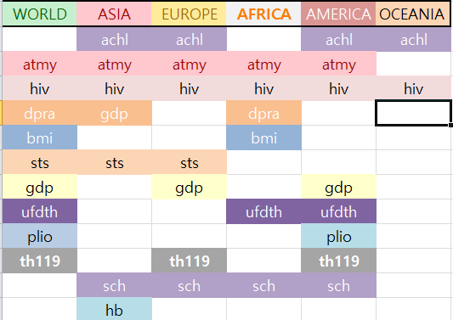
Ⅵ. Conclusions and Future Work s
6.3. Potential Improvements or Future Work
Notes:
Introduce and discuss possible methods to improve or extend your work in the future
이것은 세계와 지역의 기대수명에 대한 x variable 테이블이다.
보셨다시피 우리가 지금까지 한 데이터분석은 전세계 데이터를 바탕으로 했다, 하지만 만약에 이것을 각 지역별로 좁혀서 진행한다면,
각 지역의 평균수명에 영향을 주는 요소들이 달라진다. 따라서 우리는 각 지역에 대한 데이터분석을 통해 지역별 문제점을 인식할 수 있다.

Slide 37
Thank you

